Slide 1

Making Accessibility Accessible
Josh Dean
Mary Monroe-Ellis
Susan Mosteller
PSCCMATH.github.io

Slide 2

www.quizizz.com
Click Join a Game (upper right)
Enter the code

Slide 3
We Want to Use Word
We have hundreds of well-crafted Word documents.
We have spent hours and hours typing equations in MathType.
Our graphs are beautiful and have alternate text.
Our documents look exactly the way we want them to.

Slide 4
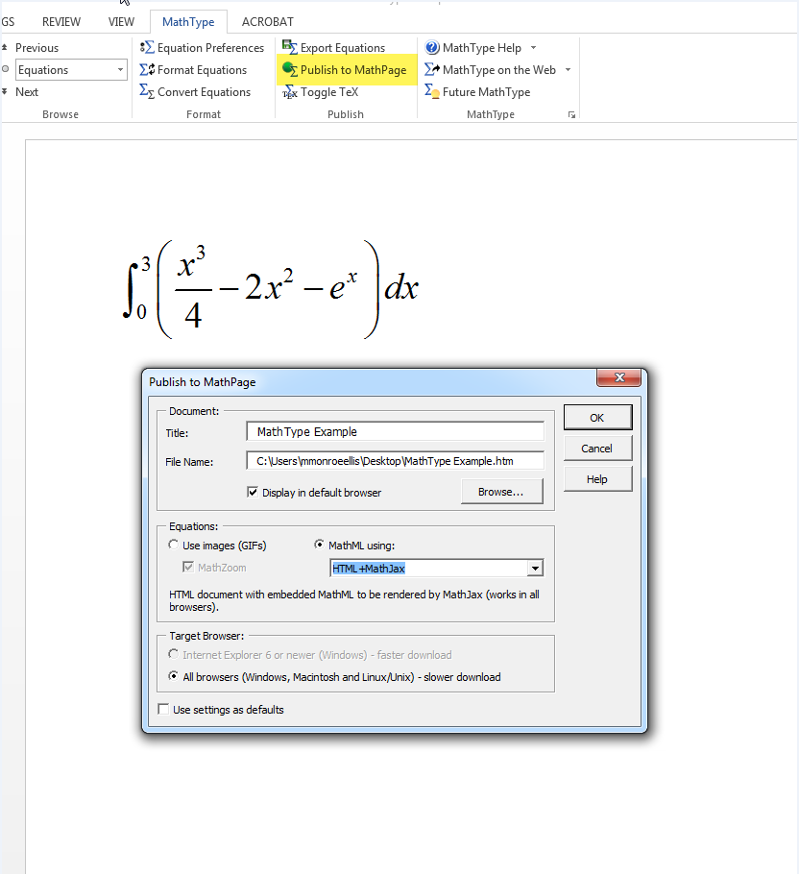
Word & MathType
Download NVDA
*MathPlayer works best on IE
Publish a Word Document to HTML
Open Word Document
Convert Equations
Publish to MathPage
Create a zip folder for HTML output
Move HTML file and folder into zip folder
Upload zip folder into D2L Brightspace
Unzip the folder in Manage Files
Add to Course Content
For each edit, you must repeat steps 1-8.

Slide 5
We Tried EVERYTHING to Keep Using Word
Word Equation editor—save as Daisy
MathType
Convert the equations
Publish to MathPage
Wouldn’t always read the equation correctly
Our graphs disappeared
Students have to download the Word document and MathPlayer
If the Word equation editor and MathType won’t do what we want, what do we do?

Slide 6
Our Journey Through the 5 Stages of Grieving
Denial – Our Word documents look really nice.
Anger – We have over 250 pages of material to make accessible.
Bargaining – Hey! MathType in Word will publish to HTML. Problem solved!
Depression – Why did MathPlayer not read that equation….how many steps does it take to fix one typo…and where in the hell are my graphs?
Acceptance – Using MarkDown to create HTML documents gives us a truly accessible course. It can be navigated with JAWS. And we’ve found our graphs!!!

Slide 7
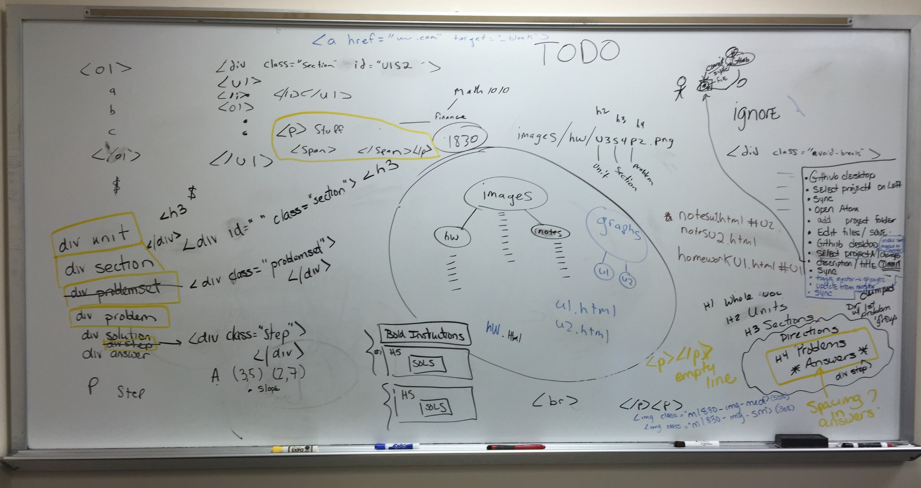
How We Got Here: From Word to HTML

Slide 8
Final Destination
Through our journey we have discovered that (for us), creating an HTML document is the easiest way to create an accessible document.

Slide 9
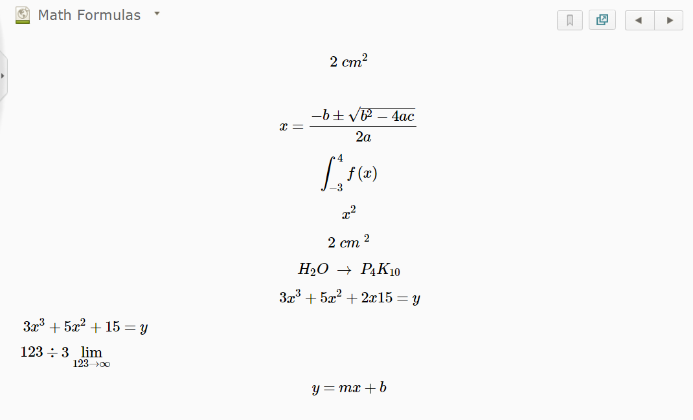
Math in Brightspace (D2L) Editor

Slide 10
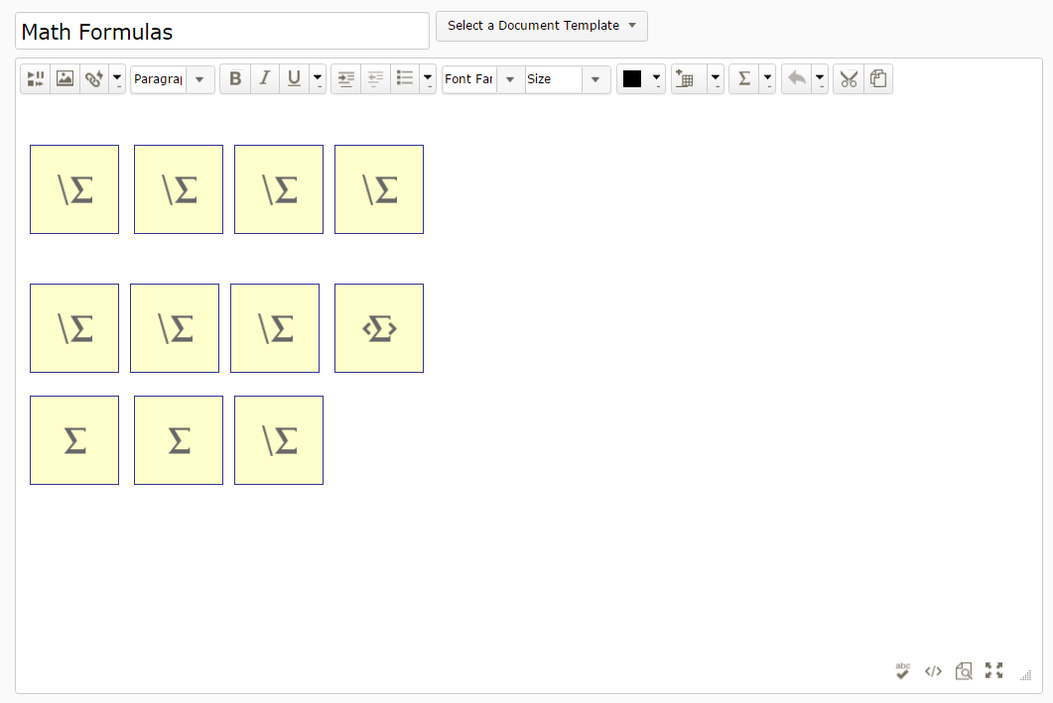
Math in Brightspace (D2L) Editor

Slide 11
The Good News Is…
Although you will be creating HTML documents, you don’t have to be a coder to make your documents beautiful.
(and you don’t have to learn any code at all if you don’t want customized formatting)

Slide 12
Word to MarkDown
MarkDown is a text-to-HTML conversion tool. MarkDown allows you to write using an easy-to-read, easy-to-write plain text format, then converts it to structurally valid XHTML (or HTML).
daringfireball.net

Slide 13
MarkDown vs. HTML Editor
HTML documents created using Markdown
Easy work flow that can begin with your existing Word documents.
We do forfeit some ability to customize our documents.
HTML documents created/edited directly in an HTML editor
More robust than Markdown – document can be fully customized.
BUT you have to know how to code HTML.

Slide 14
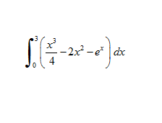

StackEdit
There are many different markdown editors.
We chose StackEdit because:
It is free.
It converts LateX formulas to HTML and MathML formulas which use the MathJax javascript library.
HTML can be typed directly into it.

Slide 15
Why Not Use Images of Equations with Alternate Text?
Images are visible and pretty on the screen and in print, BUT they require the instructor to provide adequate alternate text.
In essence you create each equation twice.

Slide 16
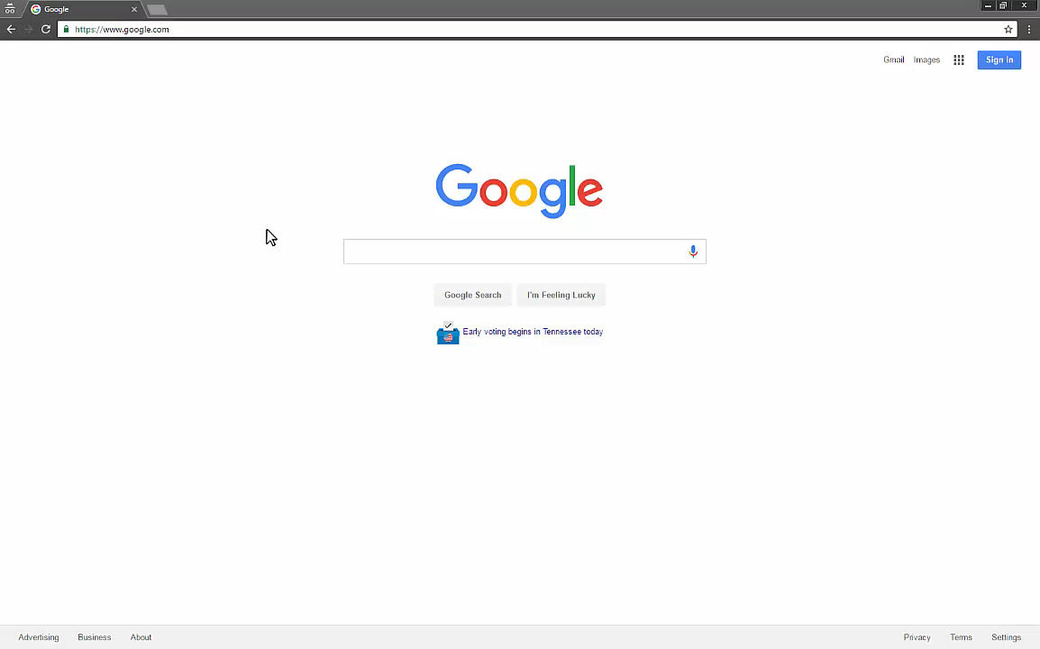
Using StackEdit
Creating new doc in StackEdit
Headings
Bold/italics
Lists
Images
Links
Equations
Tables
Export

Slide 17
Converting Word Document to Markdown
1. Copy your Word doc and paste into StackEdit.
2. Edit using
The ribbon in StackEdit
Wiris
The HTML Table Generator
HTML code
3. Publish as an HTML document.

Slide 18
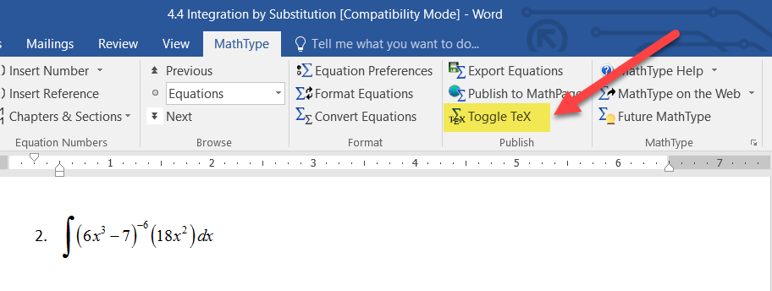
Converting Equations from MathType

Slide 19
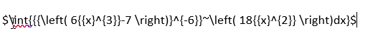
MathType vs. Wiris
MathType:
Wiris:
$\int\left(6x^3-7\right)^{-6}\left(18x^2\right)\;dx$

Slide 20
PSCCMATH.github.io

Slide 21
